Slide 1


firstStep.uk
Pitch Deck
Better together.

Slide 2


The problems.
01
02
No access or knowledge about learning possibilities
No understanding of the information about English learning possibilities

Slide 3

Our mission.
“
We want to be the first step for every migrant, to solve problems in the easiest way & to find the right courses and helpful information about their problems, without any language skills.

Slide 4



What is firstStep?
Our WebApp shows you infographics, which explain your problem and then tell you the solution.
You don’t need to speak English to find the right information
Find via firstStep courses with others on ESOL.

Slide 5
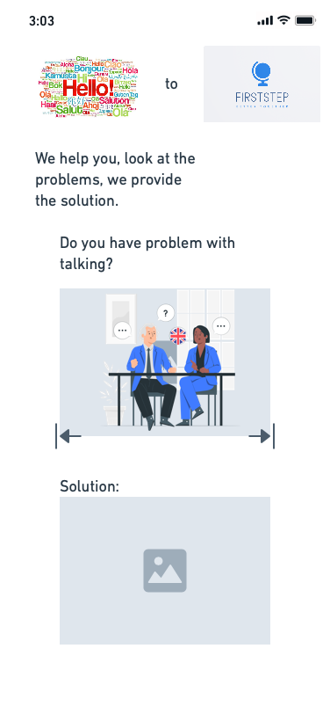




The solution
Find your problem as a picture
Find ESOL Courses
- Find the solution if you click on the picture
Connected to other helpful sources
Add problems in a agil way
Problems and solutions can be added at anytime
Notes:
In the future we want also to have a translate function for text based solutons.

Slide 6

How we manage that?
Work with grafics not text
Problem/Solution oriented
MVP with much potential
Mobil First

Slide 7
Technology
FrontEnd
BackEnd
Hosting & other Tools for Collaboration
ReactJS
MongoDB
Hosting: Heroku
Tools: Miro, Whimsical, Slack, Teams

Slide 8
Now the demo of our code:

Slide 9


Thank you and we look forward to work more on our solution
Do you have any questions, feel free to ask!
firstStep

Slide 10
Team
Adebola – Backend & FrontEnd Head
Duygu – FrontEnd
Adepeju – FrontEnd & Creation
Reem – FrontEnd & Ideation
Adem – Design & Project Managment

